Slide 1


FYP Presentation
Presented by Hendy
Academic year 2023/2024
College of Computing and Data Science
Notes:
Good Afternoon professor and examiner,
My name is Hendy, and I will be presenting on my FYP project

Slide 2
Development of application for pattern projection and comparative analysis of binary defocusing techniques in fringe projection profilometry
Project ID SCSE23-1085
Academic year 2023/2024
Project title :
Special thanks to
Supervisor Associate Professor Qian Kemao
Researchers Lyu Shenzhen and Huang Nengqi
Notes:
The title of my FYP project is –
I would like to give a special thanks to

Slide 3
Table of contents
1
2
Introduction
4
5
6
3
Comparison Methodology
Binary Dithering Techniques and Defocusing
Conclusion
Developing software for projector
Experiment and results
Notes:
Here is the overall view of the contents that I will be presenting

Slide 4
Introduction
01
Notes:
Lets start with introduction

Slide 5
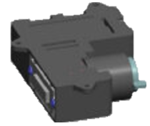

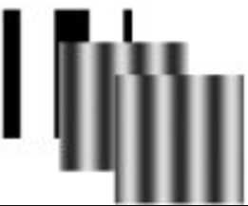
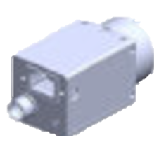
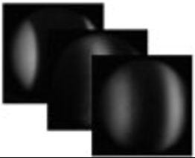
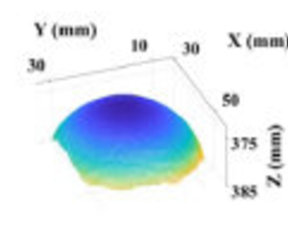
Fringe Projection Profilometry (FPP)
Calibration process
3D measurement technique
Pattern Projection
Pattern Projection
- Non-contact
- High Accuracy
- High speed
- Flexible
Image Acquisition
DLP® LightCrafter™ 6500
3D Object
Phase Measurement
Phase Unwrapping
Camera
3D reconstruction
Notes:
First, I will introduce an important concept in my FYP which is FPP.
FPP is a 3D measurement technique
Which is non contact fast and accurate and flexible to any 3D shape
FPP has been widely used in many industry.
Here are the steps

Slide 6



Project Motivation
DLP Lightcrafter 6500 is fast but presents a speed bottleneck issues
For 8-bit image is 247 Hz
For 1-bit image is ~1000 Hz
Binary dithering techniques
converts grayscale sinusoidal patterns into binary patterns (1-bit) by simulating grayscale intensity through pixel modulation.
Defocusing
smooths the sharp transitions in binary patterns, transforming them into approximate sinusoidal patterns. This reduces artifacts caused by binary edges
DLP® LightCrafter™ 6500
Notes:
In the pattern projection, there is a major issue where the projector used is fast but present a speed bottleneck when trying to represent an 8 bit image pattern
And is significantly slower compare to when trying to project 1 bit image.
This is due to the hardware limitation of the projector when trying to project the 8 bit image that contain variety of grayscale value compare to 1 bit image that only has 2 values black and white.
To resolve this, we introduce Binary dithering technique that aims to simulate the 8 bit images to closely resemble 1 bit pattern
And Defocusing technique to smooth the sharp transition in binary pattern to approx. sinusoidal pattern

Slide 7
Project Objective
Pattern Projection
Using Binary Dithering and defocusing technique to resolve the speed bottleneck issues
Develop a software to project the pattern developed to the DLP projector
Notes:
These are the 2 main objectives that I tried to achieve for this FYP
To use binary dithering technique and defocusing technique to resolve the speed bottleneck issues.
And develop a software used to upload the pattern to the projector.

Slide 8
Project Timeline
Jan 2024
March 2024
May 2024
June 2024
Oct 2024
Dec 2024
FYP start
FYP Report submission
FYP presentation
Learning and Developing Qt software
Implementing projector function into the software
Reading research papers
Implementing and Experiment for binary dithering and defocusing techniques
Notes:
FYP start 15 Jan 2024

Slide 9
Binary Dithering Techniques and Defocusing
02

Slide 10
Binary Dithering Techniques
Bayer Ordered
Error Diffusion
Optimized Phase

Slide 11

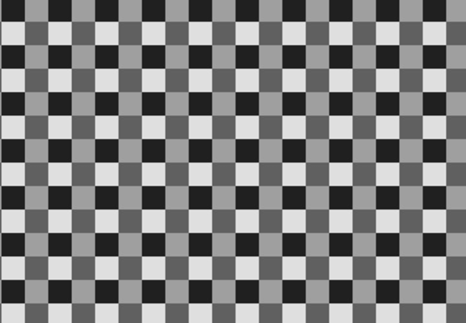
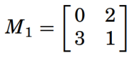
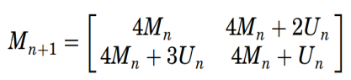

Bayer Ordered Dithering
Bayer ordered dithering is a technique used to approximate grayscale intensity in binary patterns by distributing the intensity across a grid of pixels.
Bayer Matrix
Steps :
Construct a $2^{n}$ size Bayer matrix from its base form
Intensity comparison and mapping, the Bayer matrix constructed was used to compare with the original image pixel by pixel. the values in the Bayer matrix were treated as thresholds and if the original image pixel value was bigger than threshold, the pixel was be assigned a value of “1” otherwise, it was assigned a value of “0”.
Notes:
Increasing the grid of the Bayer matrix encouraged smoother gradients and reduced visible banging. A larger Bayer matrix size also meant that the quantization error could be spread to become more effective across a bigger area of the image. However, it also increased the computation load and memory usage.

Slide 12
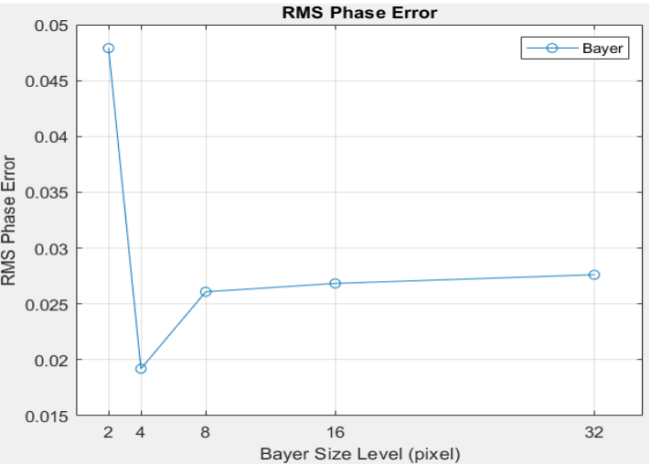
Bayer Matrix size
Notes:
Increasing the grid of the Bayer matrix encouraged smoother gradients and reduced visible banging. A larger Bayer matrix size also meant that the quantization error could be spread to become more effective across a bigger area of the image. However, it also increased the computation load and memory usage.

Slide 13
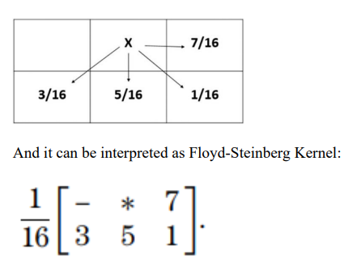
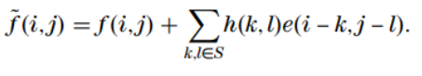
Error Diffusion Dithering
Error Diffusion dithering works by distributing the quantization errors from the original grayscale pixel value to its neighboring pixels. This method ensures that the intensity levels in the resulting binary image more closely resemble the original image’s gradients and details.
Notes:
Next is Error Diffusion Dithering that works by distributing the quantization error to its neigboring pixels through
Using the distribution metrics call Floyd Steinberg kernel
Next this are the formula to update each pixel by taking it pixel value and add it with the total distributed error.
Here is the transition of how error diffusion dithering works, which is pixel by pixel rather that grid by grid in bayer matrix

Slide 14
Optimized Phase Dithering
Enhancement of existing dithering technique designed to reduce phase errors in binary fringe patterns by Iteratively adjusts pixel values in binary patterns to closely approximate sinusoidal fringes.
Focuses on minimizing phase deviations, ensuring accurate 3D reconstruction.
Steps:
Start with an initial binary pattern (e.g., from Bayer or error diffusion dithering).
Evaluate the phase error of the pattern using RMS.
Iterative Optimization
each pixel will be inverted (0 to 1 and 1 to 0) and the difference of the phase map was computed again and if there is a reduction of the error, the inverted value was kept, and the RMS error was updated, otherwise revert the inverted pixel back.
Notes:
Lastly is optimized phase dithering that enhance existing dithering technique by iterativerly modifying the pixel value and work to aprox sinusoidal fringe
Here are the steps
1st we apply binary pattern of either the Bayer of error diffusion
Then we calculate its RMS error value
Then we proceed to modify the pixel from 0 -> 1 or 1-> 0
And calculate the error of the difference in phase map. If there is a reduction in the error, the value of the RMS error is updated, otherwise the changes of the pixel will be revert back

Slide 15
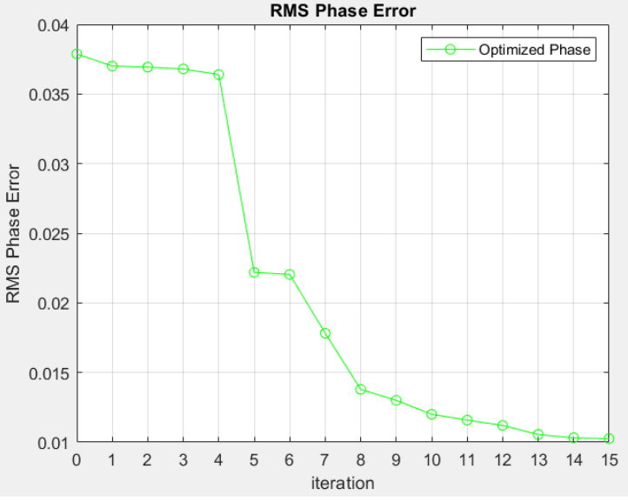
Determining the iteration
Notes:
The question we have for this technique is how many iteration should we set to perform?
For this we measured with RMS phase error and observe that the reduction of the phase error is getting smaller as the iteration and we conclude that 15 is the optimal iteration for this project

Slide 16
Comparison of Dithering Techniques
Aspect | Bayer Ordered Dithering | Error Diffusion Dithering | Optimized Phase Dithering
Complexity | Low computational complexity. | Moderate complexity due to error diffusion. | High complexity due to iterative optimization.
Speed | Very fast projection. | Slower than Bayer due to error computation. | Slow due to iterations.
Accuracy | Moderate; prone to artifacts. | High; minimizes quantization errors. | High; reduces phase deviations.
Artifacts | May introduce repetitive patterns. | Minimal artifacts. | Negligible artifacts.
Notes:
Here are the comparison of the difference dithering technique
Bayer matrix has a very fast speed with moderatwe accuracy, while error diffusion is slower due to the processing pixel by pixel
But I has hight accuracy
And optimized phase has slow speen and high accuracy

Slide 17
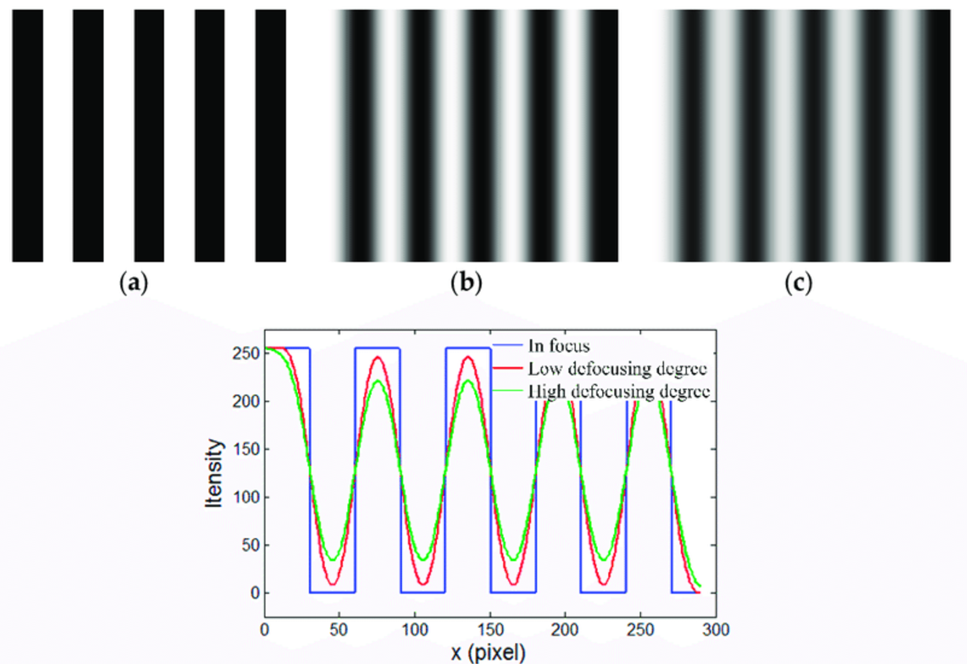
Pattern Defocusing
To ensure the project patterns closely mimic the smoothness of sinusoidal patterns, defocusing techniques were applied to the projected binary patterns.
This was critical for reducing quantization artifacts introduced by binary dithering and for achieving higher accuracy in the phase measurement of the 3D surface reconstruction.
Notes:
After the dithering process, we introduce pattern defocusing to the binary dithered image that we have
To mimic the smooth sinusoidal patterns where we can than achieve higher accuracy.

Slide 18
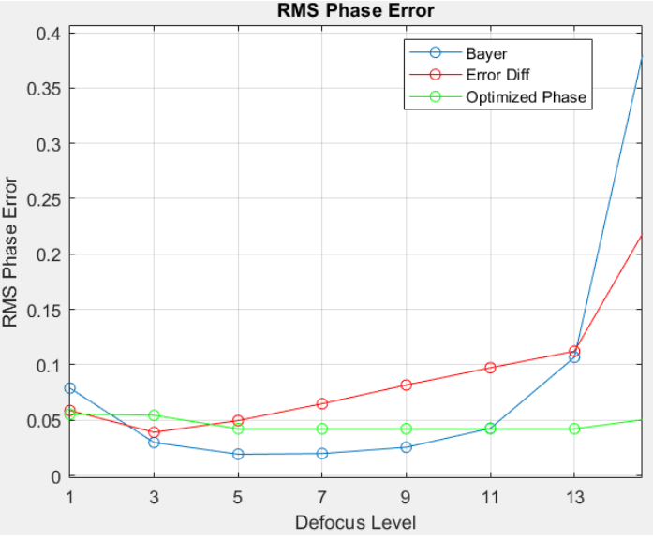
Pattern Defocusing
The most suitable Gaussian filter sizes for minimizing RMS phase
5 (error of 0.0495)
Notes:
We use gaussian filter of size 5 for this project as it yielded the lowest average error out of the 3 dithering technique.

Slide 19
Comparison Methodology
03

Slide 20
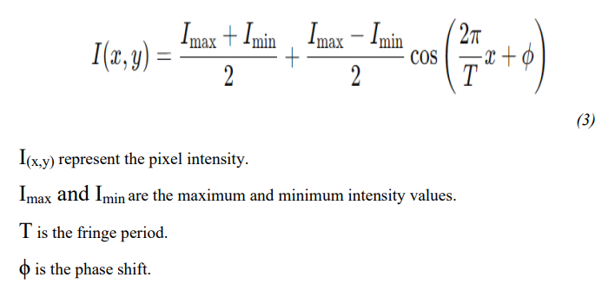
Ideal Sinusoidal
A mathematical model of a perfectly smooth and continuous wave.
Used to analyze system performance under idealized conditions.
Provides a reference baseline for evaluating other phase retrieval techniques.

Slide 21
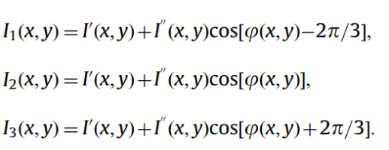
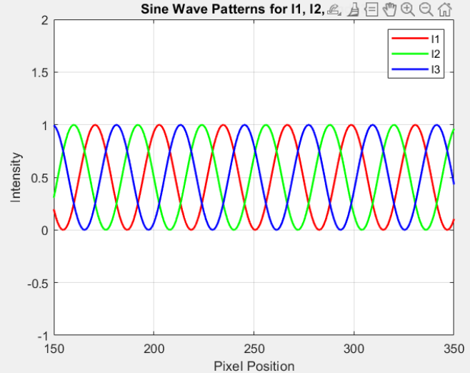
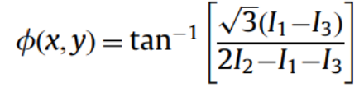

Three Phase shifting
A method to extract phase information for accurate 3D surface reconstruction.
Projects three sinusoidal patterns with ${\text{120}}^{\text{∘}}$ phase shifts:
Notes:
And 3 phase shifting is a method use to extract the 3D information by making use of 3 different intensities with different phase position shown here
that we can use to calculate the wrapped phase using this formula.

Slide 22
Comparison Methodology
Generate an Ideal sinusoidal
Three phase shifting
Generate different dithered versions
Project the patterns and compare the result

Slide 23
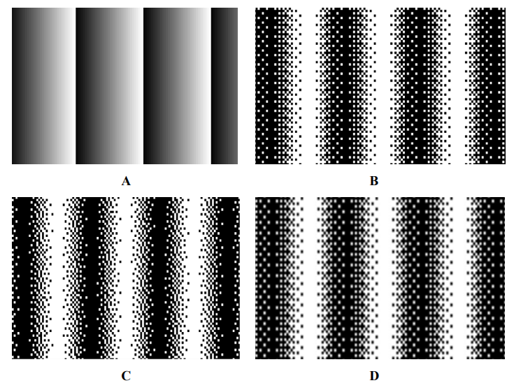
Ideal Sinusoidal vs Dithered pattern
Ideal
Bayer ordered
Error Diffusion
Optimized Phase

Slide 24
Developing software for projector
04
Notes:
Moving on is to develop our own standalone software so that we can easily modify the patterns necessary before project it using the projector.

Slide 25
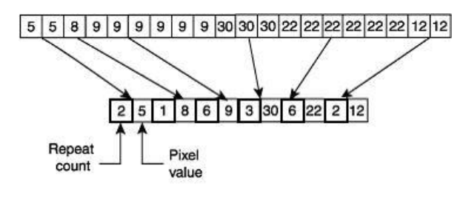
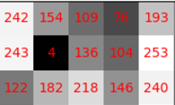
Developing software for projector
DLP® LightCrafter™ 6500
Encoded Running Length Algorithm (ERLE)
Notes:
Different patterns are upload to projector which will be encoded using encoded running length algo, here is a preview of how the algorithm works.
This helps in compressing which reduce the resources needed to store the information and perform later task.
After converting each pattern into their encoded versions, the projector has a secondary function to convert them in to a custom pattern in BMP format to be upload to the projector

Slide 26
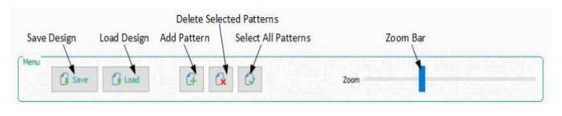
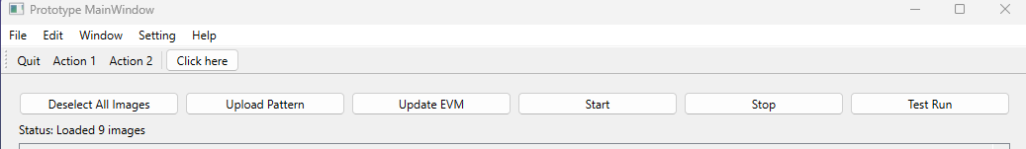
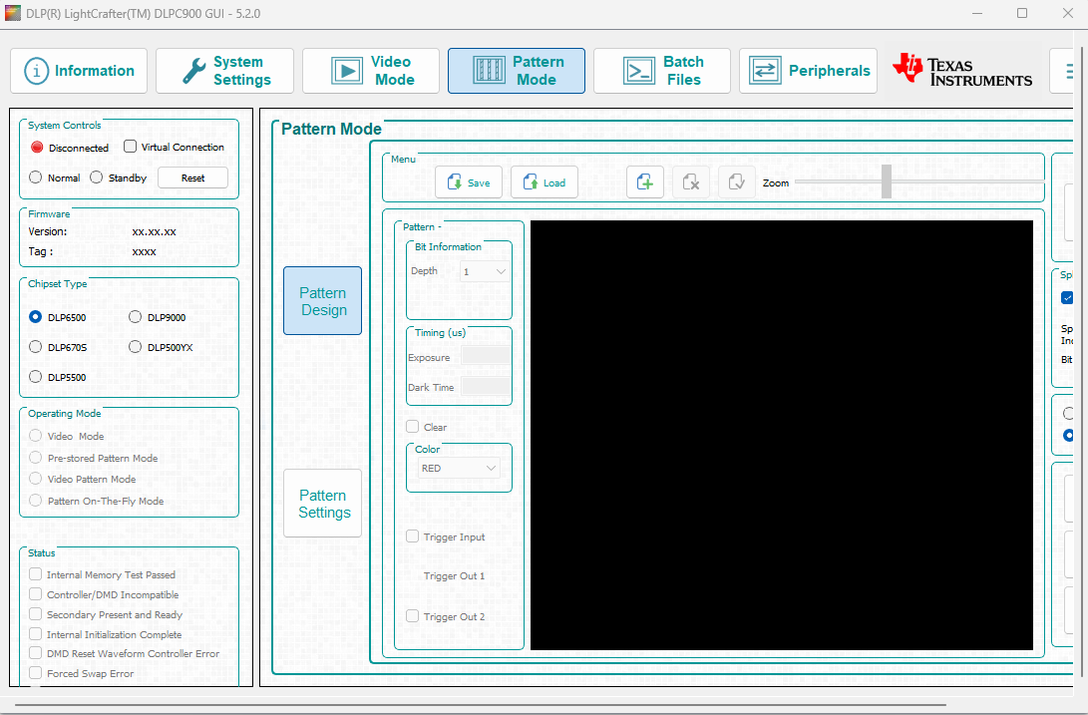
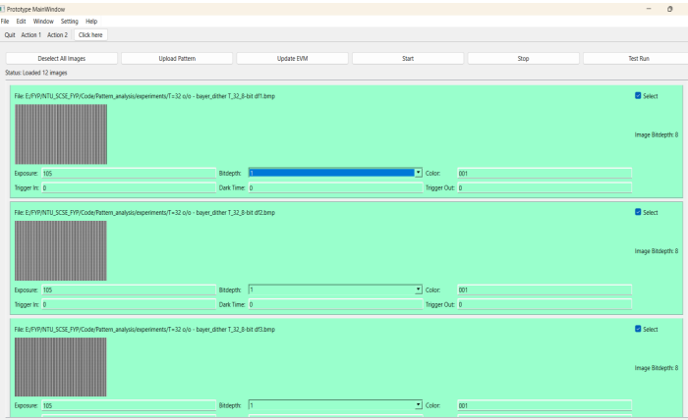
Developing software for projector
DLPC900
Prototype
Notes:
Here is an overview of the software developed by the Texas instrument and the prototype software developed by me.
Most of the common use functions such as add pattern edit the parameters of the images and upload to projector have been developed.

Slide 27
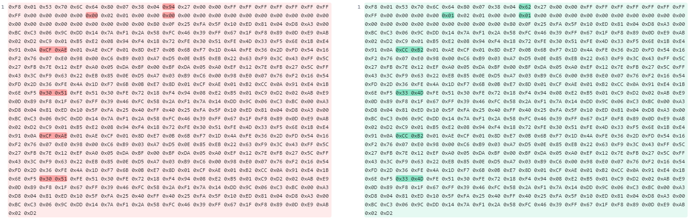
Challenges for this task
Reverse engineered to construct the algorithm
Notes:
The main challenge of this task is to work out the secondary funct

Slide 28
Experiment and results
05

Slide 29
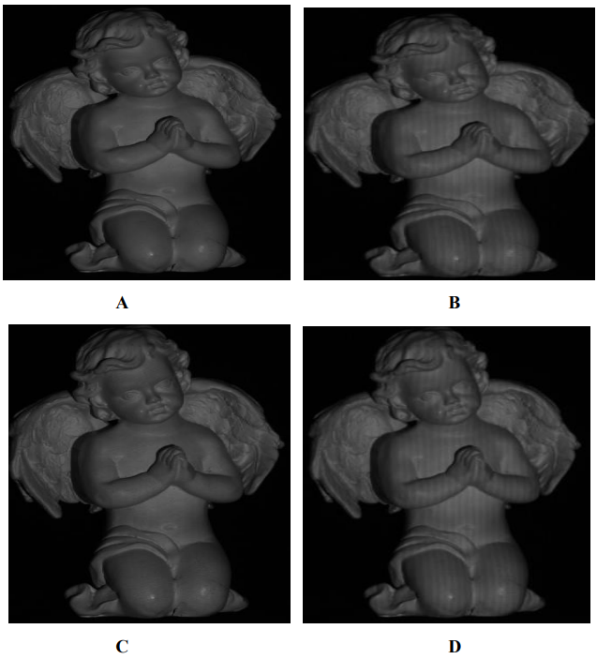
Ideal Sinusoidal vs Dithered pattern
Ideal
Bayer ordered
Error Diffusion
Optimized Phase

Slide 30
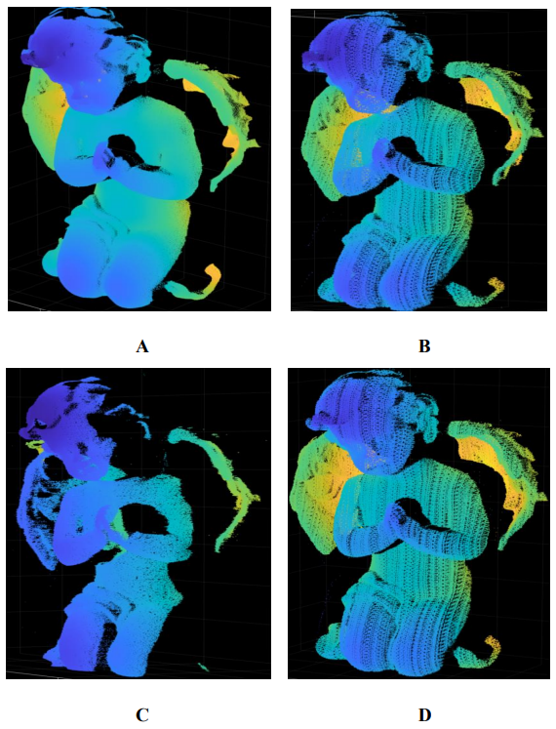
Ideal Sinusoidal vs Dithered pattern
Ideal
Bayer ordered
Error Diffusion
Optimized Phase

Slide 31
Conclusion
06

Slide 32
Conclusion and Future works
This project explored 3 different techniques of dithering; Bayer-ordered dither, Error diffusion dither, and optimized phase dither.
Through the experiment, we see that error diffusion dithering performed better than Bayer-ordered dither and optimized phase dithering.
Lastly, this project developed a standalone application using Qt to edit the patterns uploaded and update them straight to the DLP projector. The application opens the door for adding custom functions required by the user in the future.

Slide 33

Notes:
Code is = Project ID

Slide 34
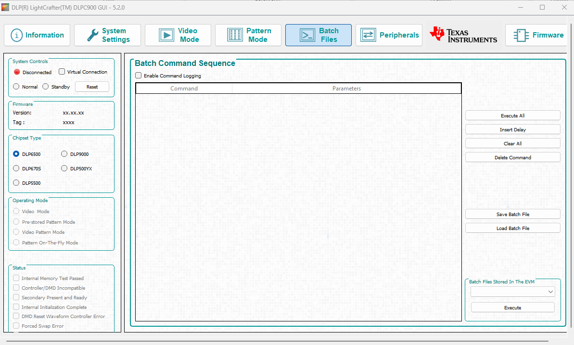
Developing software with QT

Slide 35
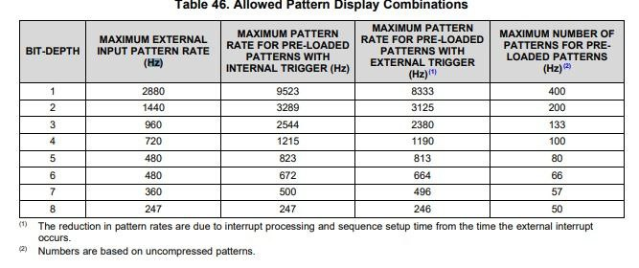
Speed bottleneck issues

